Slide 1
TEAM DEV Aniket Singh Sachin patel tushar nanda
Presenting
Splity
Split the cost, Not the friendship

Slide 2
Table of content
Problem Statement
Architecture
ER Diagram
Q&A

Slide 3
Problem statement
Difficulty in managing shared expenses among friends often leads to confusion and missed payments
Splity streamlines expense tracking and settlements, promoting fairness, transparency, and stress-free coordination

Slide 4
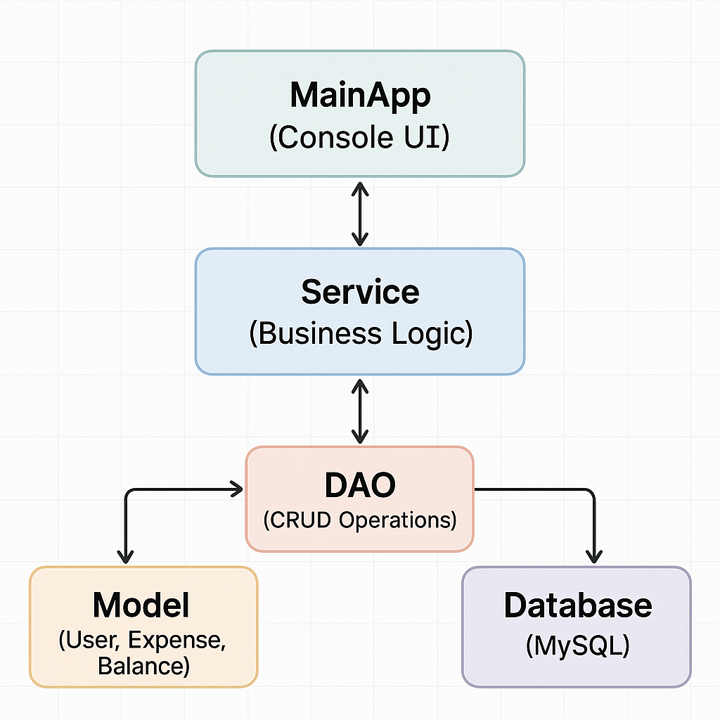
Architecture

Slide 5
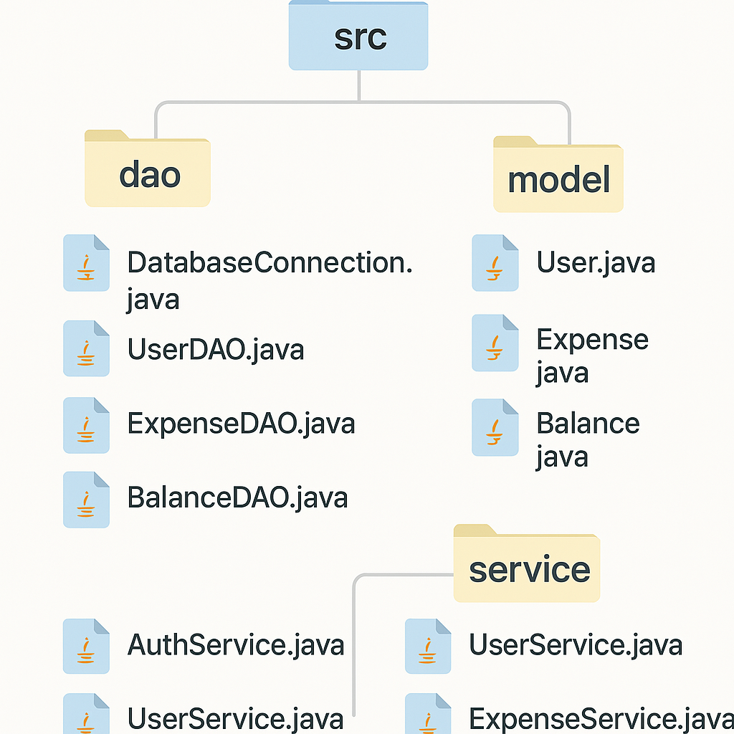
Folder structure

Slide 6
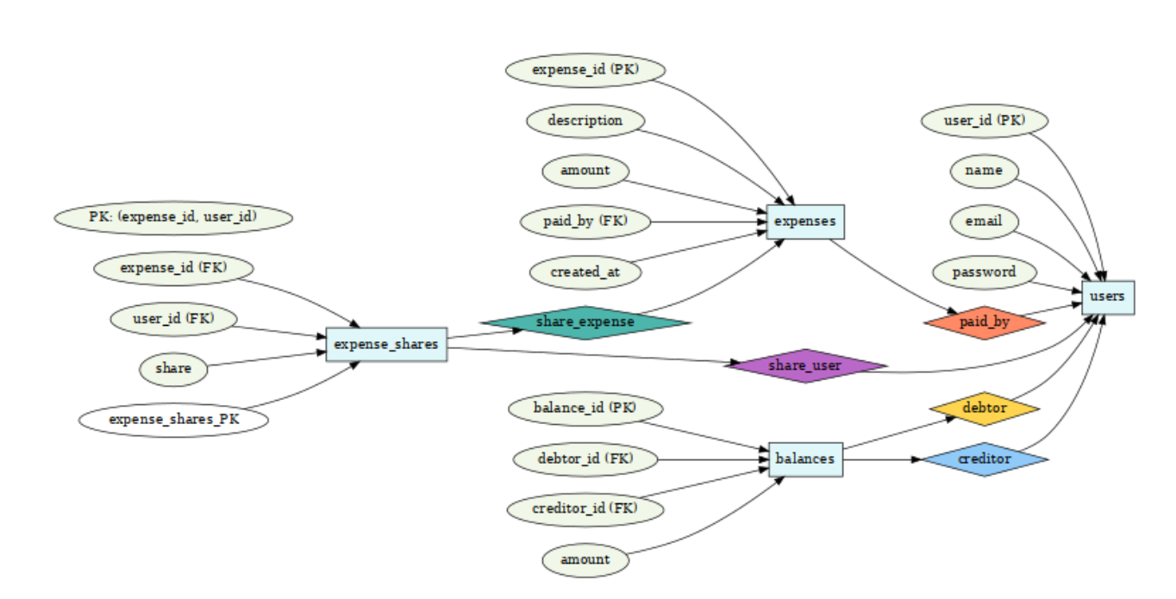
ER Diagram

Slide 7
Q&A
Any questions or thoughts?
Let’s dive into the discussion!

Slide 8
Thank you

